Slide 1
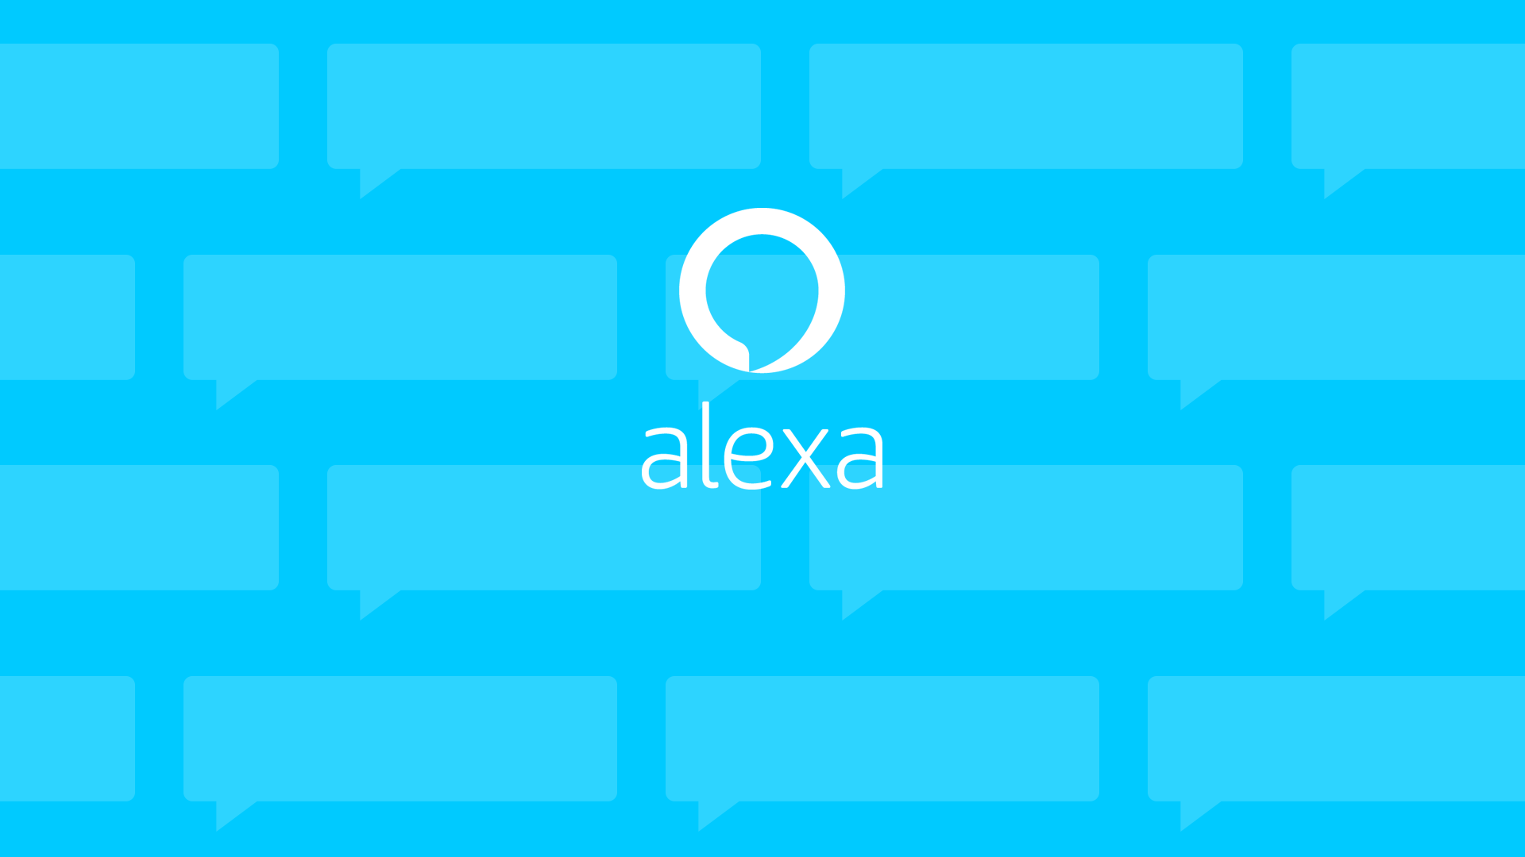
Group 4: Spelling Test Practice (Alexa Skill)

Slide 2
How can parents help their
child practice spellings?
Notes:
How can parents help their child practice spellings? There are many ways such as…
Creating crosswords or word searches
Playing hangman
flash cards
But as you may know its important for the child to have…

Slide 3

Practice tests
Notes:
For child this is beneficial in many ways…

Slide 4



WHY?
Mastery
Instant feedback
Gratification
Topic: Overview of the purpose of the project
Notes:
Why are practice tests good practice.
A child can tell which words they have mastered and which words need to be practiced more.
Provides instant feedback to the child in how to correctly spell a word.
Gratification when they spell the word correctly.

Slide 5
For a parent this is time consuming.
Notes:
For a parent and child this would mean setting aside time in the day to go over the spelling the child needs to practice

Slide 6

How can parents have time for?
Work commitments
Appointments
Family outings
Notes:
For a parent and child this would mean setting aside time in the day to go over the spelling the child needs to practice

Slide 7
Solution?
Notes:
But parents want to find time to help their child. Help them practice spelling. Help them succeed

Slide 8

An application. Which can..
Set the words to be practiced
Read out words, one at a time
Check whether each word is correct
Notes:
This application…

Slide 9

This application would..
Help pupils practice their weekly spellings
Solution for a practice test without the parent being there
Provide the child and parent with what they need

Slide 10
Purpose of this project.
Create an application that will help pupils practice their spellings for the week without their parents assistance.

Slide 11
non-technical skills learned during the project
Software Engineering Presentation

Slide 12
What are non-technical skills
In this case, it would be skills that are not related to coding.
Skills include teamwork, communication, organization and problem-solving.
Soft skills learnt whilst undertaking the project:
Teamwork – helping other team members. For instance, I showed a teammate how to use GitLab, i.e. push and pull commands.
Communication – Discord was used as a source of communication. As a group, we created different channels.
Organization – Gitlab was be useful when tracking work especially changes made to any documents.
Problem-Solving – Files in the GitLab repository had been corrupted. Thus, we had to revert everything to the previous commit.

Slide 13
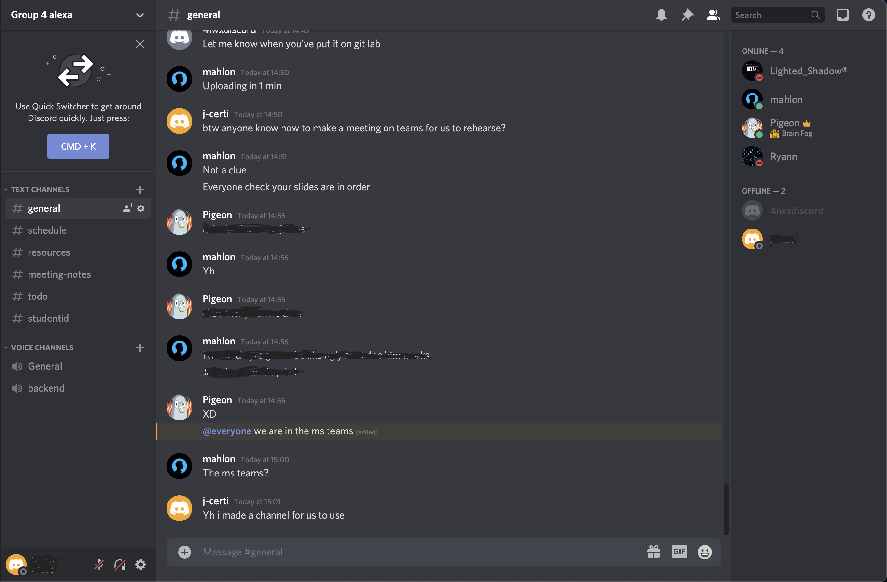
Communication via discord
A search bar which filter old, new and relevant searches.
We had different channels for different tasks.
We had different channels for different tasks.
Send and receive messages, pictures and files.
We communicate via the voice channels, i.e. for daily stand-up meeting

Slide 14
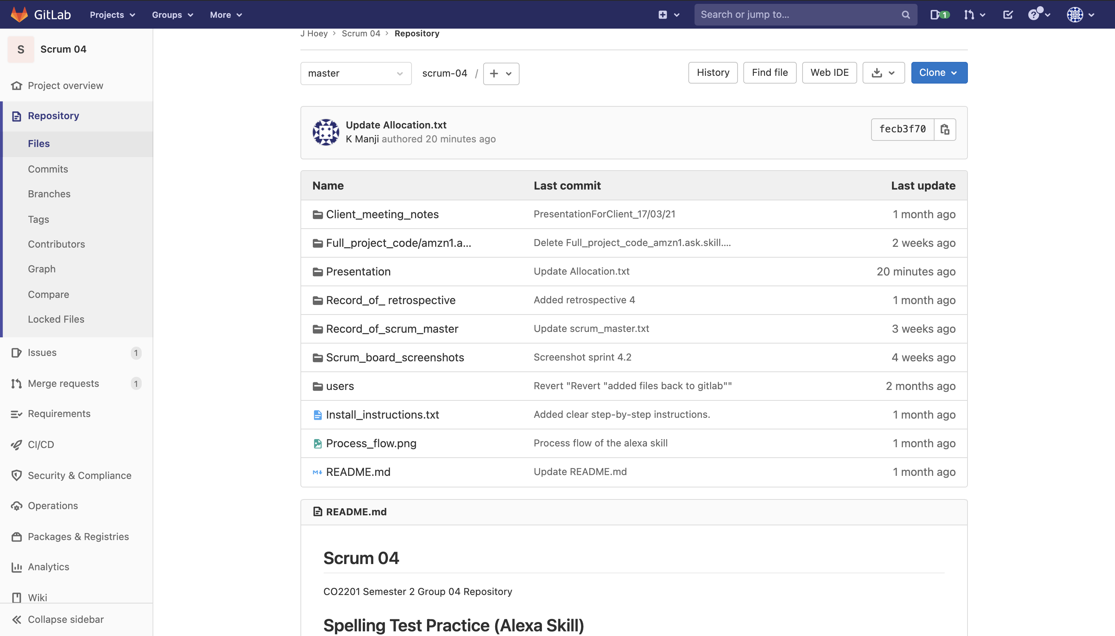
Gitlab for tracking the project (1)
GitLab allows a user to access various information regarding the project files.
Gitlab allows a user to see when a repository was last edited.
GitLab shows the repository.
Gitlab allows a user to have a message when a file was last updated. This allows other users to have an indication as to what edit has been made.
A mini project description can be set up when first creating the project.

Slide 15
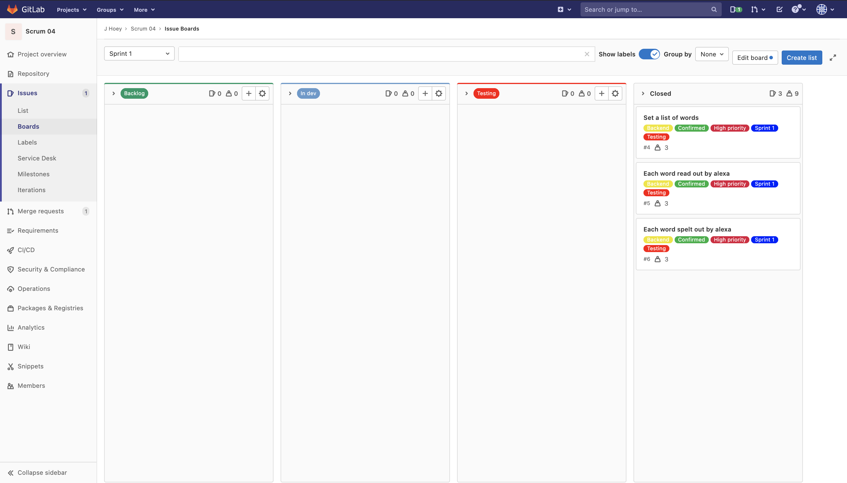
Gitlab for tracking the project (2)
GitLab allows a user to track the project similar to that of a Gantt chart.
User stories can be made in the form of issues, where tags can be assigned for additional information/tracking.
Sections can be made to track a user story/issue.

Slide 16
Non-technical skills (in-depth)
•Non-technical skills include task managing, task working, situation awareness and decision making.
•Task managing – this was shown by planning and preparing for client meetings, i.e. preparing presentation slides before a meeting.
•Task working – The scrum master would coordinate tasks accordingly, i.e. two members may be assigned to one user story, such as setting a spelling list.
•Situation awareness – I displayed awareness via deadlines, i.e. we would be aware of an upcoming deadline and would ensure the user stories are completed in time before that deadline.
•Decision making – The scrum master would undertake the decision making for most of the tasks. For instance, the scrum master would hold a meeting and set the scrum board for the upcoming week(s).
•Undertaking a project during a pandemic had its difficulties. Nonetheless, the skills learned remotely can be vital for the feature. I believe undertaking jobs remotely will be a common theme now. Thus, the skills learned will most definitely be useful.

Slide 17
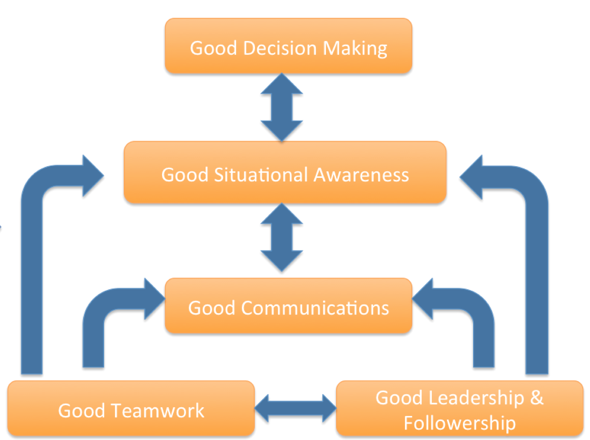

Non-technical skills - Conclusion
•The non-technical skills learnt from this project can be applied in the industry.
•When undertaking a job interview in the future, the skills learned during this project can be used as examples.
•The skills learned can be applied to any industry, not just Computer-based industries.
•Most importantly, I learned to work effectively with my teammates, such as talking in meetings despite not being camera confident and undertaking the project remotely.

Slide 18

Communication with my group throughout the project

Slide 19

How did we communicate mainly?
Discord
Quick responses
Easily accessed
Group experienced
Beneficial features

Slide 20

Did it go well?
Yes! -
0 Misunderstandings
No clashes
Very organized
Consistent

Slide 21
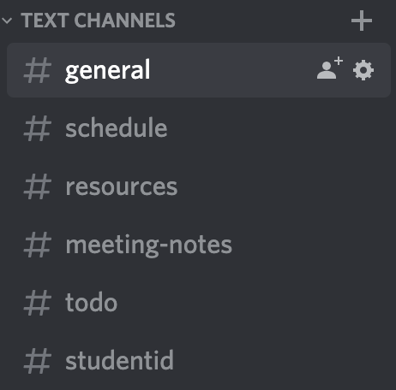
How did we achieve this?
Structured chats
Project manager
Scheduled meetings every week
Updated notes after each meeting

Slide 22

Feedback!

Slide 23
Software Architecture Decisions

Slide 24
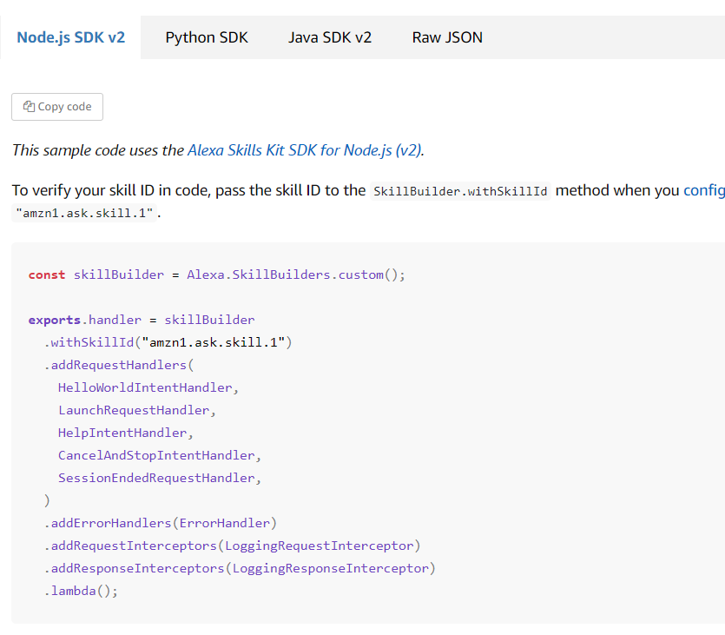
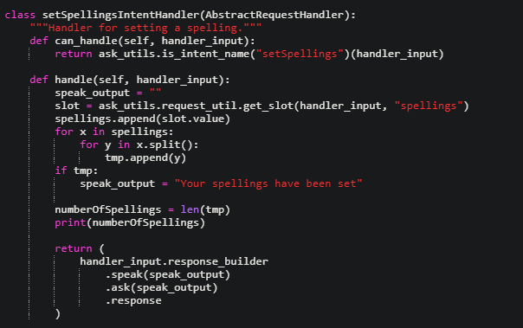
Decision 1 – Using Python
Advantages:
More Team Experience
Simple syntax, helps development time
Alternatives:
C#, Go, Java, Node.js
Java – Complicated
JavaScript – More documentation, tutorials etc

Slide 25
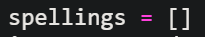
Decision 2 – Not using an SQL or NoSQL database
We decided to use a Python list to store all of our spellings.
Advantages
Faster, easier to implement – allows us to make changes more easily so less time or cost wasted.
Allowed us to code the logic behind the application first and do quicker tests on that logic faster.
Disadvantages
If the server stops running all the data is lost.
If we have multiple users then their data is shared on one account.
Alternatives
SQL through AWS lambda
DynamoDB

Slide 26
Decision 3 – Using Amazon Web Services
Advantages:
All inclusive - All the code in one console for all of the team to access. Everyone has access to the server. Alexa is from amazon so makes integration easier.
Scalable – If we ever needed resources or space we can expand
Free - We can use the services under free tier for one year
Disadvantages:
Price - Free tier is only available for 1 year after that we may be charged for continued use. AWS is expensive.
Alternatives:
Google cloud, Microsoft Azure, host our own server.

Slide 27
Social impacts
Mahlon Pope

Slide 28
More practice
Human beings have a tendency to become tired of repetitive tasks
Adults May seem unenthusiastic to help, discouraging the children from practicing
Application allows students to practice spellings endlessly

Slide 29
Improved early literacy in children
Endless practice allows for greater results in spelling tests.
An increased frequency of spelling practice can lead to greater vocabulary
Greater vocabulary means better communicative skills for children

Slide 30
Improved literacy for disadvantaged children
Some parents are unable to help their children with school work due to long working hours/ disabilities etc
These children become disadvantage at English due to their lack of support and revision
Our app allows these children practice more frequently and effectively.
Although poorer families less likely to own an Alexa so may leave even more disadvantaged.

Slide 31
Longer interactions may be discouraging
Interacting with app takes longer than a human would to mark the words
The increased time could make spelling practice more boring and discourage it
This would result in poorer spelling test results and confidence in spelling

